Slide 1
Planter project
Smartgrow
By: Gelzen and Sam
2024

Slide 2
An automated plant care system
Able to water the plant periodically or when needed
Able to turn on plant light
Interface and view information (remote and onsite)
System overview

Slide 3
Computer control
Arduino UNO
Gets the sensor readings when commanded by ESP
ESP initiates the command when Central sends a HTTP GET request
Wifi control
ESP8266
Two way communication between control computer and arduino control
Identified by ENUM
Communication

Slide 4
Water schedule
Temperature and humidity
Soil moisture levels
Light schedule
Time of day
Light levels
Automated features

Slide 5
System read specs
Sensor | Ranges
Temperature | 0-50 Celcius
Humidity | 20-80%
Light level | Dark < 150 Bright >= 150
Soil moisture | Dry > 400 Wet < 300
Water level | 0-400

Slide 6
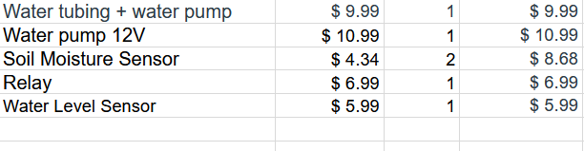
Total cost: $42.64
Costs

Slide 7
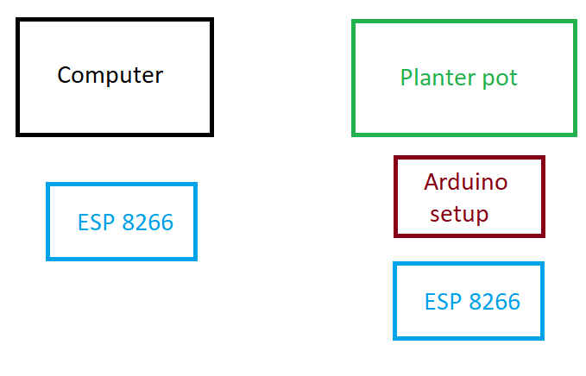
System

